Slide 1
Classroom slides - pipelining

Slide 2


Bill’s Sandwich shop
Station 1 station II station III station IV station V
(place order) (select bread) (cheese) (meat) (veggies)

Slide 3
Bill’s Sandwich shop
Station 1 station II station III station IV station V
(place order) (select bread) (cheese) (meat) (veggies)

Slide 4
Bill’s Sandwich shop
Station 1 station II station III station IV station V
(place order) (select bread) (cheese) (meat) (veggies)

Slide 5
Bill’s Sandwich shop
Station 1 station II station III station IV station V
(place order) (select bread) (cheese) (meat) (veggies)

Slide 6
Bill’s Sandwich shop
Station 1 station II station III station IV station V
(place order) (select bread) (cheese) (meat) (veggies)

Slide 7
Bill’s Sandwich shop
Station 1 station II station III station IV station V
(place order) (select bread) (cheese) (meat) (veggies)

Slide 8

Bill’s Mega-Sandwich shop
Station 1 station II station III station IV station V
(place order) (select bread) (cheese) (meat) (veggies)
New (5th order) 4th order 3rd order 2nd order 1st order
"What'll Ya Have?"
Manager

Slide 9
Fetch
Decode
Execute
Instruction
in
Instruction
out
I₁

Slide 10
Fetch
Decode
Execute
Instruction
in
Instruction
out
I₁

Slide 11
Fetch
Decode
Execute
Instruction
in
Instruction
out
I₁

Slide 12
Fetch
Decode
Execute
Instruction
in
Instruction
out
I₂

Slide 13
Fetch
Decode
Execute
Instruction
in
Instruction
out
I₂

Slide 14
Fetch
Decode
Execute
Instruction
in
Instruction
out
I₂

Slide 15
instructions
I₁
F
D
E
I₂
F
D
E
I₃
F
D
E
I₄
F
D
E
I₅
.
.
.
.
………….
……….
time
1 2 3 4 5 6 7 8 9 ………………….

Slide 16
LC
-
2200 Datapath
32
LdPC
PC
LdA
A
B
LdB
LdMAR
MAR
LdIR
IR
10
WrREG
Din
Addr
Din
IR[31..0]
2
registers
WrMEM
memory
ALU:
4
16x
1024x
func
IR[19..0]
00: ADD
regno
32 bits
32 bits
01: NAND
20
10: A
-
B
Dout
Dout
11: A + 1
sign
extend
DrPC
DrALU
DrREG
DrMEM
DrOFF
=0?
IR[27..24]
Rx: 4
-
bit register number to control logic
1
IR[23..20]
Ry: 4
-
bit register number to control logic
LdZ
Z
IR[3..0]
Rz: 4
-
bit register number to control logic
IR[31..28]
OP: 4
-
bit
opcode
to control logic
1
Z: 1
-
bit
boolean
to control logic

Slide 17
Macro State Units in Use
FETCH IR, ALU, PC, MEM
DECODE IR
EXECUTE (ADD) IR, ALU, Reg-file
EXECUTE (LW) IR, ALU, Reg-file MEM, Sign extender

Slide 18
instructions
I₁
F
D
E
I₂
F
D
E
I₃
F
D
E
I₄
F
D
E
I₅
.
.
.
.
………………….
………………….
time
1 2 3 4 5 6 7 8 9 ………………….

Slide 19
Bill’s Mega-Sandwich shop
Station 1 station II station III station IV station V
(place order) (select bread) (cheese) (meat) (veggies)
New (5th order) 4th order 3rd order 2nd order 1st order
"What'll Ya Have?"
Manager

Slide 20
instructions
I₁
F
D
E
I₂
F
D
E
I₃
F
D
E
I₄
F
D
E
I₅
.
.
.
.
………………….
………………….
time
1 2 3 4 5 6 7 8 9 ………………….

Slide 21
LC-2200 Instruction set
R-type instructions (add, nand):
bits 31-28: opcode
bits 27-24: reg X; bits 23-20: reg Y
bits 19-4: unused (should be all 0s); bits 3-0: reg Z
I-type instructions (addi, lw, sw, beq):
bits 31-28: opcode; bits 27-24: reg X
bits 23-20: reg Y; bits 19-0: Imm. Offset
J-type instructions (jalr):
bits 31-28: opcode; bits 27-24: reg X
bits 23-20: reg Y; bits 19-0: unused
O-type instructions (halt):
bits 31-28: opcode; bits 27-0: unused

Slide 22
IF
ID/RR
EX
MEM
WB
Instruction
in
Instruction
out
I₅
I₄
I₃
I₂
I₁

Slide 23
B
U
F
F
E
R
B
U
F
F
E
R
B
U
F
F
E
R
B
U
F
F
E
R
IF
ID/RR
EX
MEM
WB
Instruction
in
Instruction
out

Slide 24
STAGE Units in Use
FETCH ALU, PC, MEM
ID/RR Reg-file, decode logic
EXEC ALU
MEM MEM
WB Reg-file

Slide 25
IF
ID/RR
EXEC
MEM
WB
B
U
F
F
E
R
B
U
F
F
E
R
B
U
F
F
E
R
B
U
F
F
E
R
PC
DPRF
ALU
D-MEM
data
I-MEM
A
B
Decode
logic
DPRF
ALU
FBUF
DBUF
EBUF
MBUF
Name | Output of Stage | Contents
FBUF | IF | Primarily contains instruction read from memory
DBUF | ID/RR | Decoded IR and values read from register file
EBUF | EX | Primarily contains result of ALU operation plus other parts of the instruction depending on the instruction specifics
MBUF | MEM | Same as EBUF if instruction is not LW or SW; If instruction is LW, then buffer contains the contents of memory location read

Slide 26
Anatomy of ADD instruction
IF stage (cycle 1)
ID/RR stage (cycle 2)
EX stage (cycle 3)
MEM stage (cycle 4)
WB stage (cycle 5)

Slide 27
Considering only the Add instruction,
quantify the sizes of the various buffers
between the stages of the above pipeline.
FBUF?
DBUF?
EBUF?
MBUF?

Slide 28
How do you generalize design of pipeline register?
Look at all instructions in the ISA
Decide what needs to be carried over from one stage to the next
Opcode other fields

Slide 29
Design the DBUF pipeline register for LC-2200.
Do not attempt to optimize the design by
overloading the different fields of this register.

Slide 30
Structural Hazard
B
U
F
F
E
R
B
U
F
F
E
R
B
U
F
F
E
R
B
U
F
F
E
R
I₄
BEQ
I₂
I₁
I₀
IF
ID/RR
EX
MEM
WB

Slide 31
Structural Hazard
Cycle 1
B
U
F
F
E
R
B
U
F
F
E
R
B
U
F
F
E
R
B
U
F
F
E
R
I₄
BEQ
I₂
I₁
I₀
IF
ID/RR
EX
MEM
WB
Feedback lines

Slide 32
Cycle 2
B
U
F
F
E
R
B
U
F
F
E
R
B
U
F
F
E
R
B
U
F
F
E
R
I₅
I₄
BEQ
I₂
I₁
IF
ID/RR
EX
MEM
WB
STAY
STAY
Feedback lines

Slide 33
Cycle 3
B
U
F
F
E
R
B
U
F
F
E
R
B
U
F
F
E
R
B
U
F
F
E
R
I₅
I₄
BEQ
NOP
I₂
IF
ID/RR
EX
MEM
WB
Feedback lines

Slide 34
Cycle 4
B
U
F
F
E
R
B
U
F
F
E
R
B
U
F
F
E
R
B
U
F
F
E
R
I₆
I₅
I₄
BEQ
NOP
IF
ID/RR
EX
MEM
WB
Feedback lines

Slide 35
IF
ID/RR
EXEC
MEM
WB
B
U
F
F
E
R
B
U
F
F
E
R
B
U
F
F
E
R
B
U
F
F
E
R
PC
DPRF
ALU-1
D-MEM
data
I-MEM
A
B
ALU-2
Decode
logic
DPRF
ALU

Slide 36
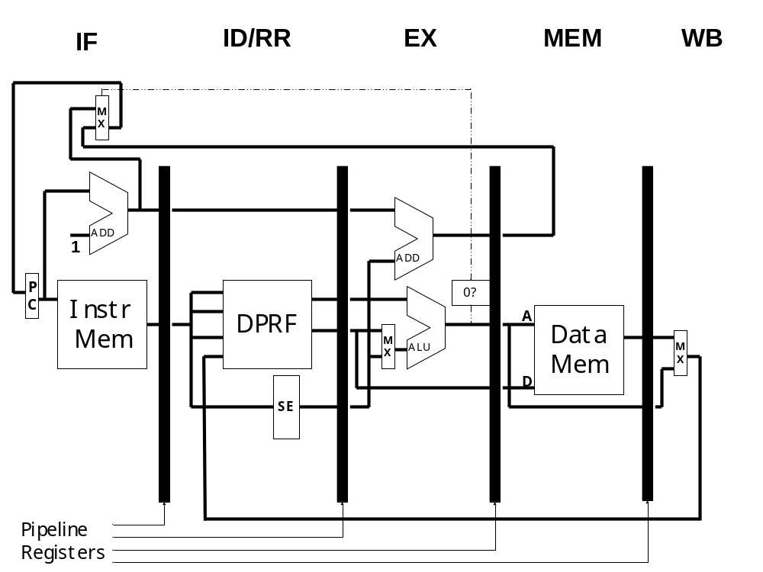

Slide 37
Data Hazard
RAW
I₁: R1 <- R2 + R3
I₂: R4 <- R1 + R5
WAR
I₁: R4 <- R1 + R5
I₂: R1 <- R2 + R3
WAW
I₁: R1 <- R4 + R5
I₂: R1 <- R2 + R3
True dependency
Anti dependency
Output dependency

Slide 38
I₁: R1 <- R2 + R3
I₂: R4 <- R1 + R5
Cycle 1
IF
ID/RR
EX
MEM
WB
I₂
I₁
IF
ID/RR
EX
MEM
WB
Cycle 2
I₂
I₁

Slide 39
Fix – introduce bubbles
IF
ID/RR
EX
MEM
WB
I₂
NOP
NOP
NOP
I₁
Register file
B
B
B
B
B
B
B
B

Slide 40
RAW hazard
I₁: R1 <- R2 + R3
I₂: R4 <- R1 + R5
B
U
F
F
E
R
I₂
B
U
F
F
E
R
I₁
B
U
F
F
E
R
B
U
F
F
E
R
IF
ID/RR
EX
MEM
RW
Reg-file
R1 not ready to be read

Slide 41
RAW hazard
I₁: R1 <- R2 + R3
I₂: R4 <- R1 + R5
B
U
F
F
E
R
I₂
B
U
F
F
E
R
I₁
B
U
F
F
E
R
B
U
F
F
E
R
IF
ID/RR
EX
MEM
RW
Reg-file
R1 not ready to be read

Slide 42
B
U
F
F
E
R
I₂
B
U
F
F
E
R
NOP
B
U
F
F
E
R
I₁
B
U
F
F
E
R
IF
ID/RR
EX
MEM
RW
Reg-file
R1 not ready to be read

Slide 43
B
U
F
F
E
R
I₂
B
U
F
F
E
R
NOP
B
U
F
F
E
R
NOP
B
U
F
F
E
R
I₁
IF
ID/RR
EX
MEM
RW
R1 is being
written
Reg-file
R1 not ready to be read

Slide 44
B
U
F
F
E
R
I₂
B
U
F
F
E
R
NOP
B
U
F
F
E
R
NOP
B
U
F
F
E
R
NOP
I₁
IF
ID/RR
EX
MEM
RW
Reg-file
R1 is ready to be read

Slide 45
I₁: R1 <- R2 + R3
I₂: R4 <- R4 + R3
I₃: R5 <- R5 + R3
I₄: R6 <- R1 + R6
IF
ID/RR
EX
MEM
WB
I₁

Slide 46
Cycle Number | IF | ID/RR | EX | MEM | WB
1 | I₁ | - | - | - | -
2 | I₂ | I₁ | - | - | -
3 | I₃ | I₂ | I₁ | - | -
4 | I₄ | I₃ | I₂ | I₁ | -
5 | - | I₄ | I₃ | I₂ | I₁
6 | - | I₄ | NOP | I₃ | I₂
7 | - | - | I₄ | NOP | I₃
8 | - | - | - | I₄ | NOP
9 | - | - | - | - | I₄

Slide 47
Register forwarding
Register file
B
RP
B
RP
B
RP
B
RP
B
RP
B
RP
B
RP
B
RP

Slide 48
B
U
F
F
E
R
I₂
B
U
F
F
E
R
I₁
B
U
F
F
E
R
B
U
F
F
E
R
IF
ID/RR
EX
MEM
RW
Reg-file
R1 value forwarded
from EX stage
R1 not ready to be read

Slide 49
RAW hazard
I₁: R1 <- R2 + R3
…..
I₂: R4 <- R1 + R5
Number of unrelated instructions Between I₁ and I₂ | Number of bubbles Without forwarding | Number of bubbles With forwarding
0 | 3 | 0
1 | 2 | 0
2 | 1 | 0
3 or more | 0 | 0

Slide 50
Control hazard
Cycle IF* ID/RR EX MEM WB
1 BEQ
2 ADD
3 NAND
4 LW
* We do not actually know what the instruction is in the Fetch Stage

Slide 51
Conservative handling of branches
Cycle IF* ID/RR EX MEM WB
1 BEQ
2 ADD BEQ
3 ADD+ NOP BEQ
4 NAND ADD NOP BEQ
5 LW NAND ADD NOP BEQ
* We do not actually know what the instruction is in the Fetch Stage
+ ADD instruction is stalled in the IF stage until the BEQ is resolved
Assumes branch was unsuccessful
What if branch was successful?

Slide 52
Given the following sequence of instructions:
BEQ L1
ADD
LW
….
L1 NAND
SW
Using conservative approach and assuming branch
is taken, what is the observed CPI for the
3 instructions (BEQ, NAND, SW)?

Slide 53
Cycle Number | IF | ID/RR | EX | MEM | WB
1 | BEQ | - | - | - | -
2 | ADD | BEQ | - | - | -
3 | ADD | NOP | BEQ | - | -
4 | NAND | NOP | NOP | BEQ | -
5 | SW | NAND | NOP | NOP | BEQ
6 | - | SW | NAND | NOP | NOP
7 | - | - | SW | NAND | NOP
8 |  |  | - | SW | NAND
9 |  |  |  | - | SW

Slide 54
Branch prediction
Cycle IF* ID/RR EX MEM WB
1 BEQ
2 ADD BEQ
3 NAND ADD BEQ
4 LW NAND ADD BEQ
5 ... LW NAND ADD BEQ
* We do not actually know what the instruction is in the Fetch Stage

Slide 55
B
U
F
F
E
R
B
U
F
F
E
R
B
U
F
F
E
R
B
U
F
F
E
R
NAND
ADD
BEQ
IF
ID/RR
EX
MEM
WB
flush

Slide 56
Given the following sequence of instructions:
BEQ L1
ADD
LW
….
L1 NAND
SW
Using conservative approach and assuming branch
is NOT taken, what is the observed CPI for the
3 instructions (BEQ, ADD, LW)?

Slide 57
Cycle Number | IF | ID/RR | EX | MEM | WB
1 | BEQ | - | - | - | -
2 | ADD | BEQ | - | - | -
3 | LW | ADD | BEQ | - | -
4 | - | LW | ADD | BEQ | -
5 | - | - | LW | ADD | BEQ
6 | - | - | - | LW | ADD
7 | - | - | - | - | LW
What if prediction turns out false?

Slide 58
Cycle Number | IF | ID/RR | EX | MEM | WB
1 | BEQ | - | - | - | -
2 | ADD | BEQ | - | - | -
3 | LW | ADD | BEQ | - | -
4 | NAND | NOP | NOP | BEQ | -
5 | SW | NAND | NOP | NOP | BEQ
6 | - | SW | NAND | NOP | NOP
7 | - | - | SW | NAND | NOP
8 |  |  | - | SW | NAND
9 |  |  |  | - | SW
Prediction failed…squash ADD and LW,
and send NOPs

Slide 59
Delayed branch – before opt
; Add 7 to each element of a ten-element array
; whose address is in a0
addi t1, a0, 40 ; When a0=t1 we are done
loop:
beq a0, t1, done
nop ; branch delay slot
lw t0, 0(a0)
addi t0, t0, 7
sw t0, 0(a0)
addi a0, a0, 4
beq zero, zero, loop
nop ; branch delay slot
done: halt

Slide 60
Delayed branch – after opt
addi t1, a0, 40 ; When a0=t1 we are done
loop:
beq a0, t1, done
lw t0, 0(a0) ; branch delay slot
addi t0, t0, 7
sw t0, 0(a0)
beq zero, zero, loop
addi a0, a0, 4 ; branch delay slot
done: halt

Slide 61
Branch Target Buffer
PC branch instruction
Taken/Not taken
PC branch target

Slide 62
Name | Pros | Cons | Use cases
Stall the pipeline | Simple strategy, no hardware needed for squashing instructions | Loss of performance | Early pipelined machines such as IBM 360 series
Branch Prediction (branch not taken) | Results in good performance with small additional hardware since the instruction is anyhow being fetched from the sequential path already in IF stage | Needs ability to squash instructions in partial execution in the pipeline | Most modern processors such as Intel Pentium, AMD Athlon, and PowerPC use this technique; typically they also employ sophisticated branch target buffers; MIPS R4000 uses a combination 1-delay slot plus a 2-cycle branch-not-taken prediction
Branch Prediction (branch taken) | Results in good performance but requires slightly more elaborate hardware design | Since the new PC value that points to the target of the branch is not available until the branch instruction is in EX stage, this technique requires more elaborate hardware assist to be practical | -
Delayed Branch | No need for any additional hardware for either stalling or squashing instructions; It involves the compiler by exposing the pipeline delay slots and takes its help to achieve good performance | With increase in depth of pipelines of modern processors, it becomes increasingly difficult to fill the delay slots by the compiler | Older RISC architectures such as MIPS, PA-RISC, SPARC

Slide 63
Instruction | Type of Hazard | Potential Stalls | With Data forwarding | With branch prediction (branch not taken)
ADD, NAND | Data | 0, 1, 2, or 3 | 0 | Not Applicable
LW | Data | 0, 1, 2, or 3 | 0 or 1 | Not Applicable
BEQ | Control | 1 or 2 | Not Applicable | 0 (success) or 2 (mispredict)

Slide 64
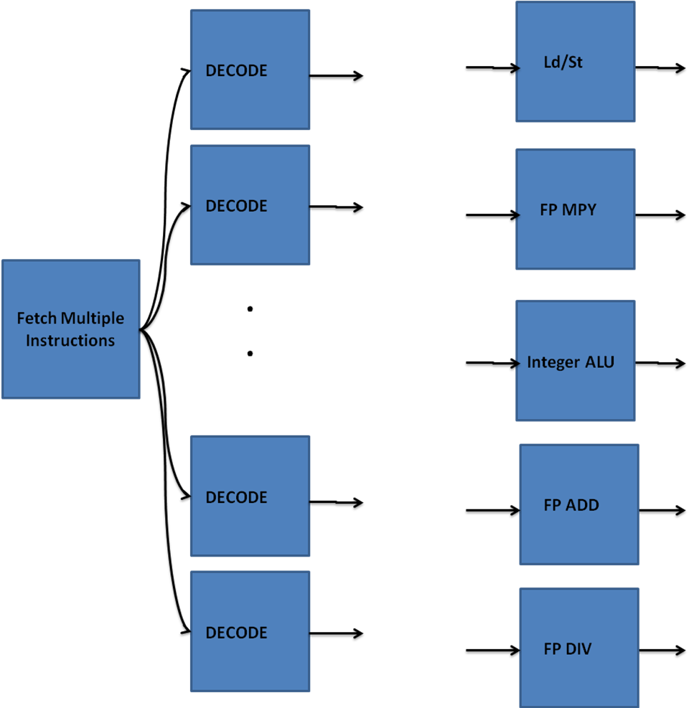
Deeper pipelines

Slide 65
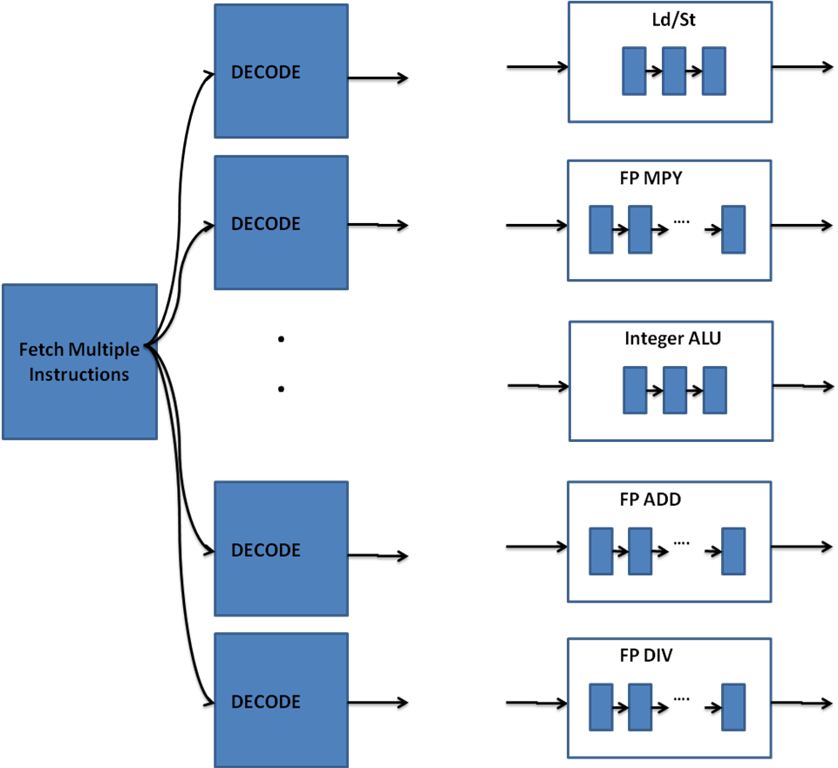
Different Pipeline Depths

Slide 66
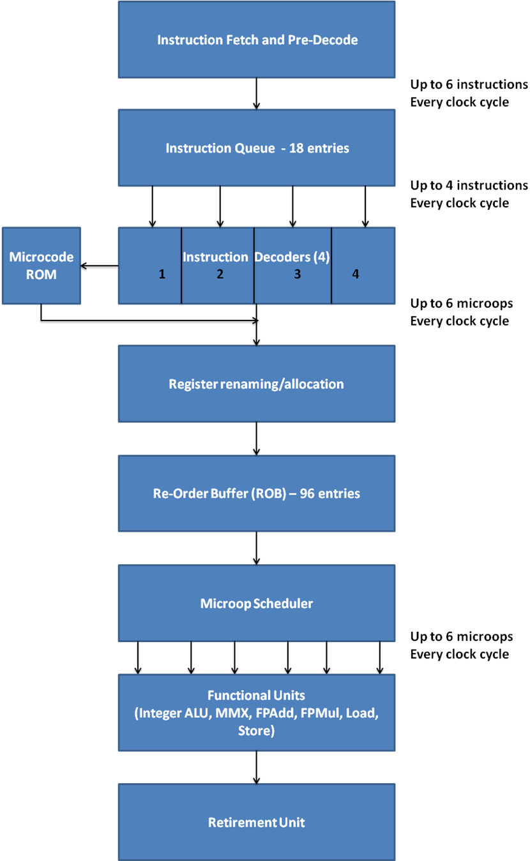
Intel Core Microarchitecture:
An example pipeline

Slide 67
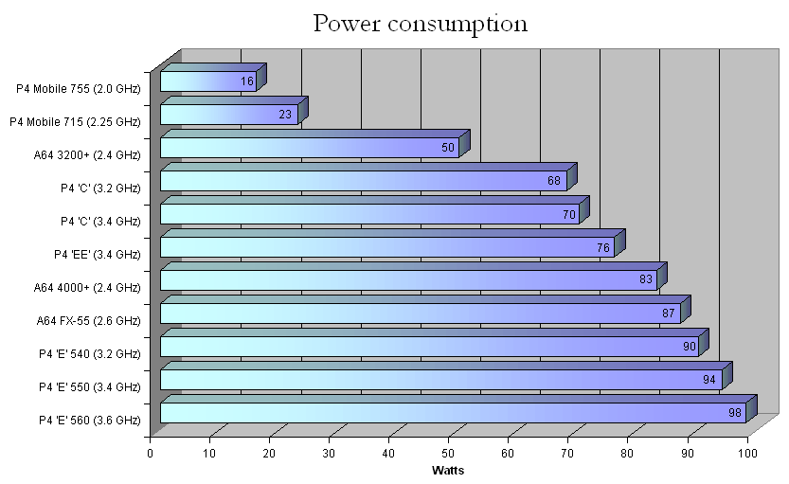
Advanced topics - Power
Source: http://en.wikipedia.org/wiki/CPU_power_dissipation

